Slide 1
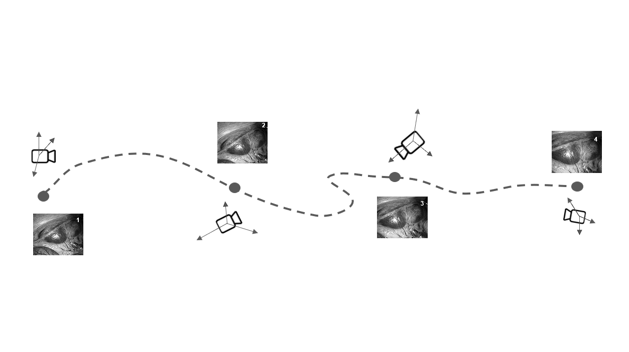
PROJECT N°7
CAMERA POSE ESTIMATION from surgical videos
With Deep Learning
STUDENTS :
Andrea Naclerio
Ali Shadman Yazdi
Siavash Taleghani
TUTOR :
Alberto Rota

Slide 2
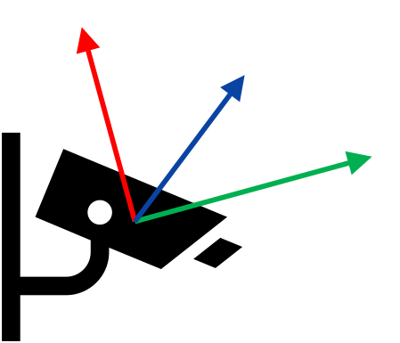
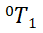
Camera Pose Estimation
What is camera pose estimation?
A homogeneous transformation matrix that describes position and orientation of a camera
Why do we need camera pose?
3D reconstruction
Enhanced perception
Organs and lesions localization
=
R
T
Z
L
0 0 0
1
Y
X
O
Notes:
Improve

Slide 3

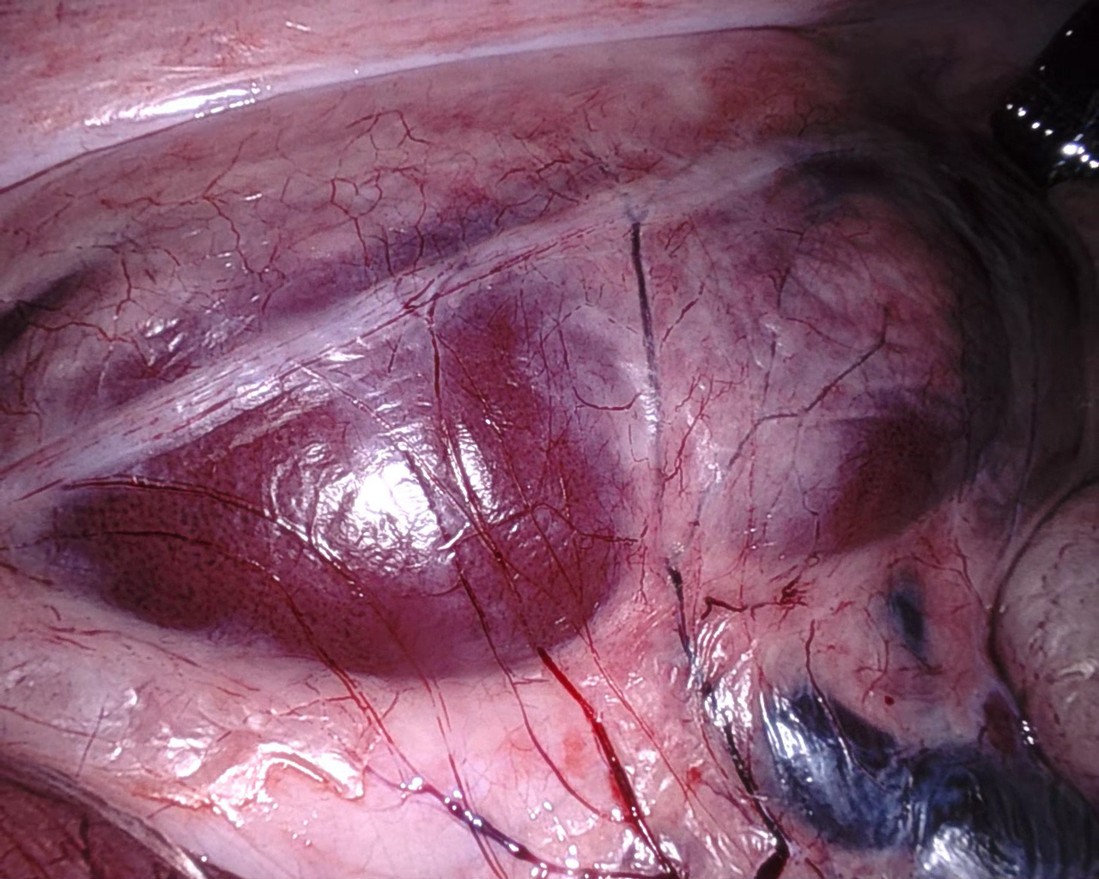

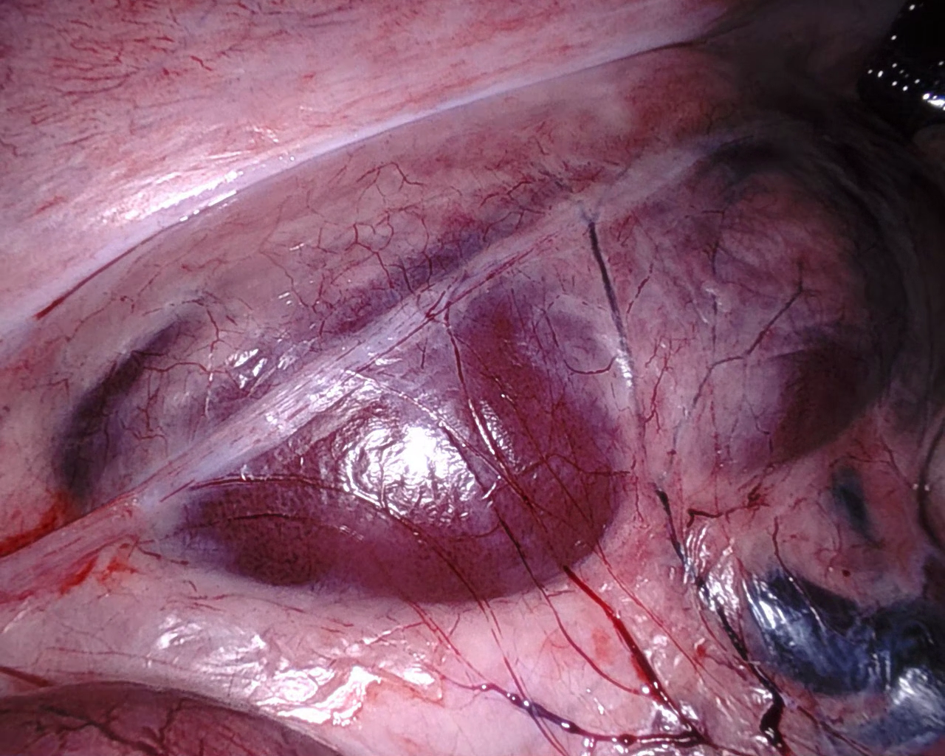
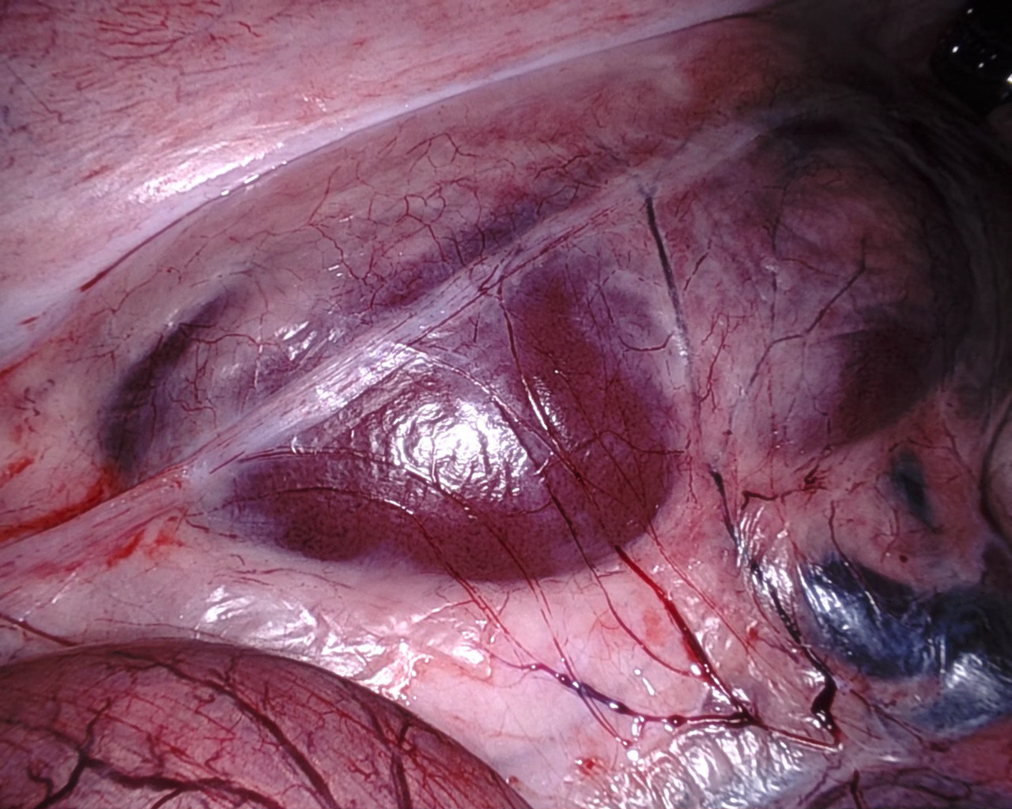
State of the art
Visual SLAM
Tracking points of interest
3D positioning through triangulation
Developing 3D map
Deep Learning
Feature extraction through DCNN
Camera pose and image information relationship establishment
Predicting camera pose
i = 3
4
i = 2
Z
=
R
T
Y
3
i
i = 1
2
0 0 0
1
1
1
X
O

Slide 4
Sources of ambiguities using monocular endoscopy in MIS*:
Non-rigidity of human tissues
Organ motion (e.g. breathing)
Deformation by instruments
Texture-less tissues
Lambertian Reflection
*Minimally Invasive Surgery

Slide 5
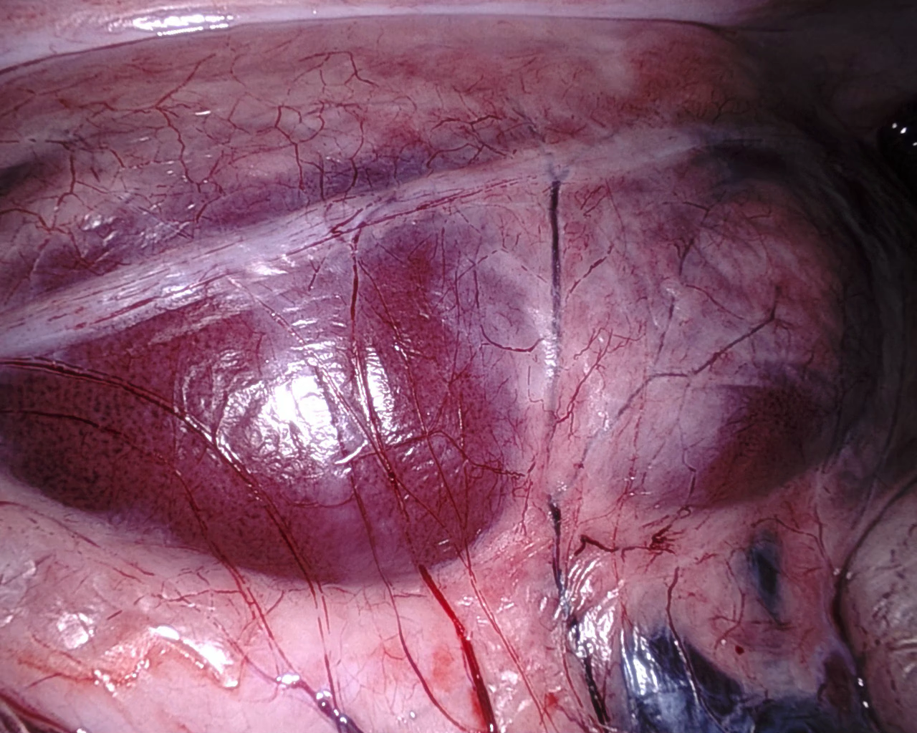
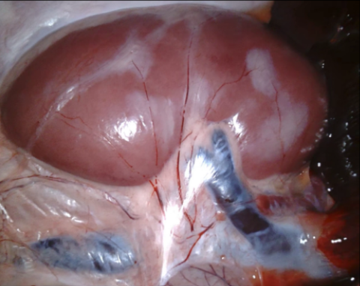
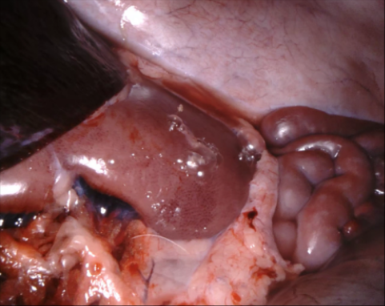

Our Approach
4
3
2
1
DATASET
FRAMES
27 monocular videos
annotated
2
4
3
1
Notes:
Dataset (video - frames - matrix global RF) → trajectory with the different frames
Global RF → Local RF
Pose matrix → 3 position + 3 orientation (minimum and sufficient)

Slide 6

VIDEOS
TRAJECTORY + ORIENTATION
(ground truth)
TRAINING
FULLY SUPERVISED MODEL
TEST
FULLY SUPERVISED MODEL

Slide 7
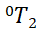
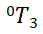
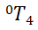
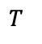
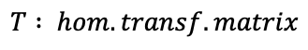
Ground-Truth data
2
4
3
1
z
0
y
ROT. MATRIX
=
POSITION
$$T : hom. transf. matrix$$
$$T$$
x
0 0 0 1

Slide 8
Problem decomposition
2
4
3
1
1
2
2 frames
per step
2
3
DEEP LEARNING MODEL
3
4
2
4
1
3

Slide 9
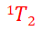
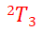
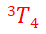
New transformation matrix
2
4
3
1
z
0
y
x

Slide 10
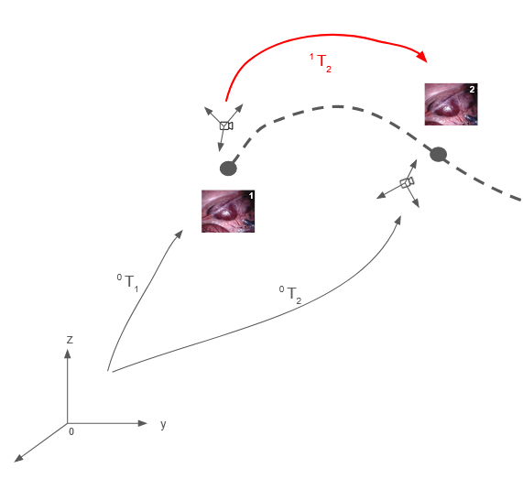
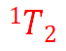
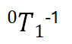
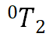
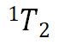
Output computation
=
*
=
ROT. MATRIX
POSITION
0 0 0 1
ROT. MATRIX
[ 𝛼 , 𝛽 , 𝛾 ]
[ 𝑥 , 𝑦 , 𝓏 ]
POSITION
x
Notes:
ATTENZIONE ATTENZIONE : Vedere bene come ricavare euler angles partendo dalla rot matrix. Vedere anche l’altra rappresentazione (roll pitch yaw) → attenzione nel caso di singolarità

Slide 11
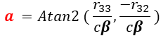
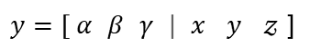
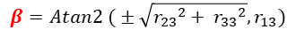
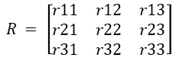
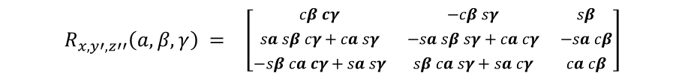
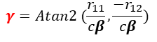
INVERSE PROBLEM
[ 𝛼 , 𝛽 , 𝛾 ]
ROTATION MATRIX
EULER ANGLES
$$R_{x, y′,z′′}\left(a,β,γ\right) = \left[\begin{matrix}cβ cγ & −cβ sγ & sβ \\ sa sβ cγ+ca sγ & −sa sβ sγ+ca cγ & −sa cβ \\ −sβ ca cγ+sa sγ & sβ ca sγ+sa cγ & ca cβ\end{matrix}\right]$$
$$R_{ }= \left[\begin{matrix}r11 & r12 & r13 \\ r21 & r22 & r23 \\ r31 & r32 & r33\end{matrix}\right]$$
$$β=Atan2 ( ± \sqrt{{r_{23}}^{2}+ {r_{33}}^{2}}, r_{13})$$
$$a =Atan2 ( \frac{r_{33}}{cβ}, \frac{−r_{32}}{cβ} )$$
$$γ=Atan2 (\frac{r_{11}}{cβ}, \frac{−r_{12}}{cβ})$$
$y=\text{[ }\text{α} \text{β} \text{γ} \text{| }\text{x} \text{y} \text{𝓏}$ ]

Slide 12
Two tails architecture
n
DL MODEL
𝛼
𝛽
𝛾
DENSE
𝑥
𝑦
𝓏
𝑥 𝑦 𝓏
n+1
DL MODEL
FEATURE EXTRACTOR
REGRESSOR
Feature vector previous frame
Feature vector following frame

Slide 13
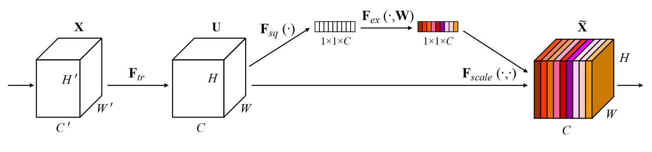
From scratch architecture
CONV 2D
CONV 2D
CONV 2D
CONV 2D
SE BLOCK
SE BLOCK
ReLu
SE BLOCK
ReLu
SE BLOCK
ReLu
MAX POOLING
ReLu
BATCH NORM
MAX POOLING
BATCH NORM
MAX POOLING
BATCH NORM
BATCH NORM
MAX POOLING
FLATTENING
DL MODEL
SE BLOCK
GAP
DENSE
DENSE
RESHAPE
MULTIPLY

Slide 14
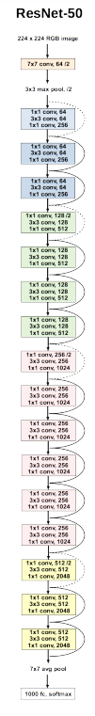
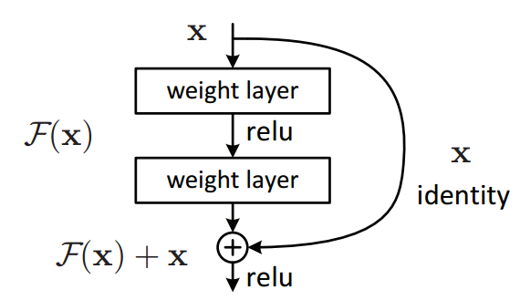
ResNet50 MODEL
ResNet-50 introduced the concept of residual learning to address the challenge of training very deep neural networks and mitigating the vanishing gradient problem.
A residual block contains a shortcut or skip connection that skips one or more layers, allowing the network to learn the residual (difference) between the input and output of those skipped layers.
Weights were initialized to pre-trained model from image-net, but adjusted to fit our dataset during training
"Instead of figuring out the entire journey, let's figure out the changes we need to make at each step, and then just add those changes to the starting point.“
- chat GPT et al.(2024)

Slide 15
Model training
FROM SCRATCH MODEL
RESNET50 MODEL
- TRAINING VIDEOS : 3 (v2, v3, v4)
- NUM. TRAINIGN IMAGES : 1784
- TEST VIDEO: 1 (v1)
- LOSS FUNCTION : Mean Square Error (MSE)
- BATCH : 12
- LEARNING RATE (LR) : 0.0001
- CALLBACKS:
- EARLY STOPPING PATIENCE : 12
- REDUCE LR ON PLATEU FACTOR : 6
- NUM. PARAMETERS : 40 millions
- TRAINING VIDEOS : 3 (v2, v3, v4)
- NUM. TRAINIGN IMAGES : 1784
- TEST VIDEO: 1 (v1)
- LOSS FUNCTION : Mean Square Error (MSE)
- BATCH : 4
- LEARNING RATE (LR) : 0.0001
- CALLBACKS:
- EARLY STOPPING PATIENCE : 10
- REDUCE LR ON PLATEU FACTOR : 3
- NUM. PARAMETERS : 340 millions

Slide 16
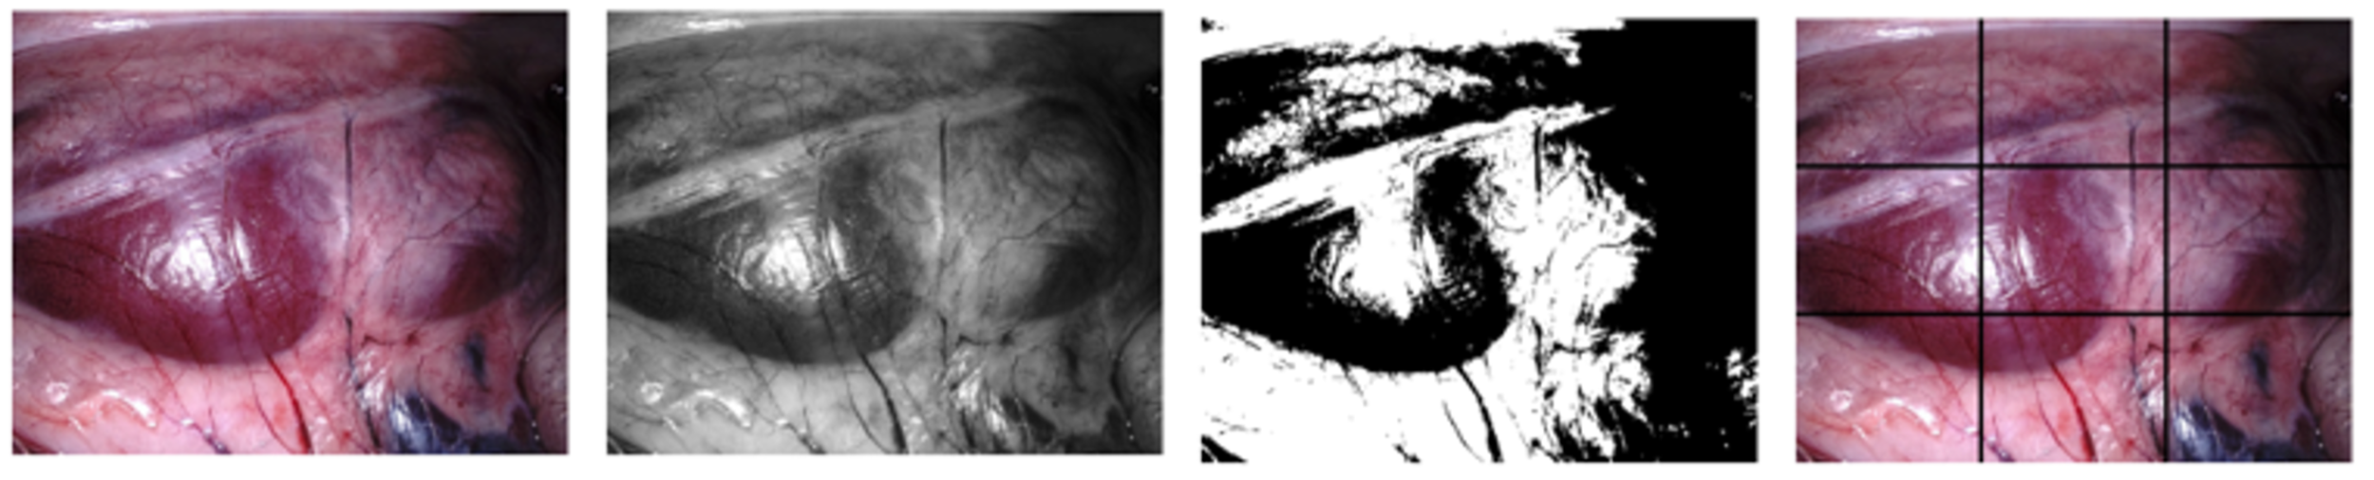
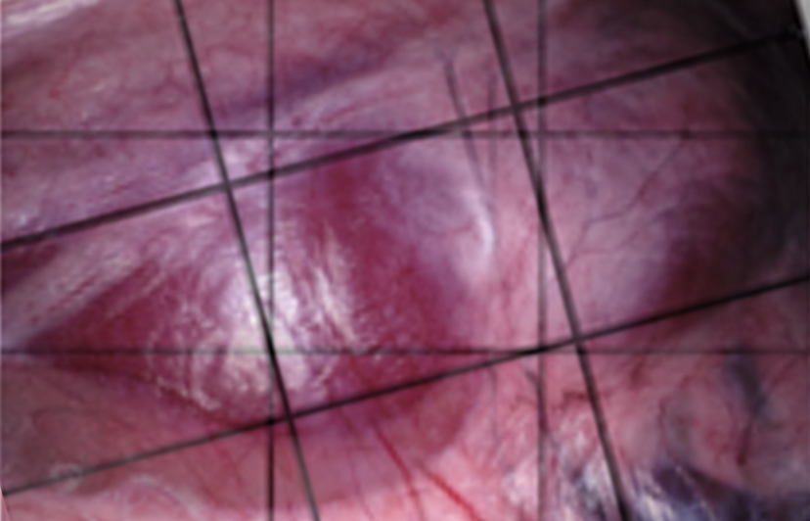
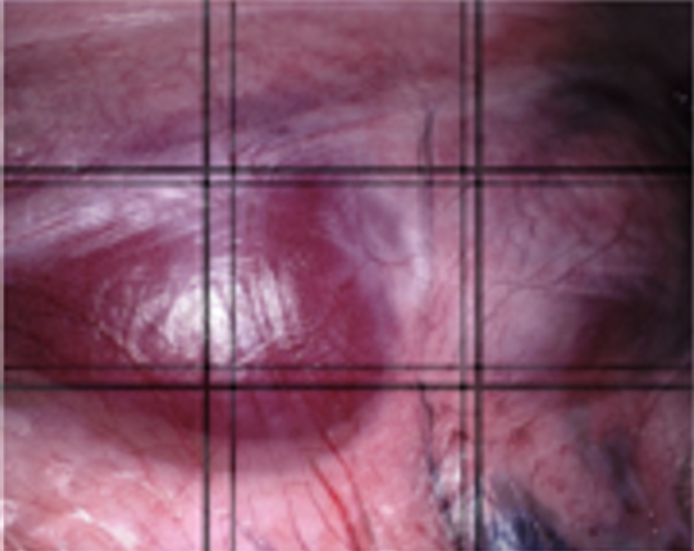
Image preprocessing
RGB image → (m, 512, 640, 3) → 983,040 data points per image
Binary image → (m, 512, 640, 1) → 327,680 data points per image

Slide 17
Effects of preprocessing
Translation error
Rotation error
Base line
--
--
Grayscale
Binary
Grid

Slide 18
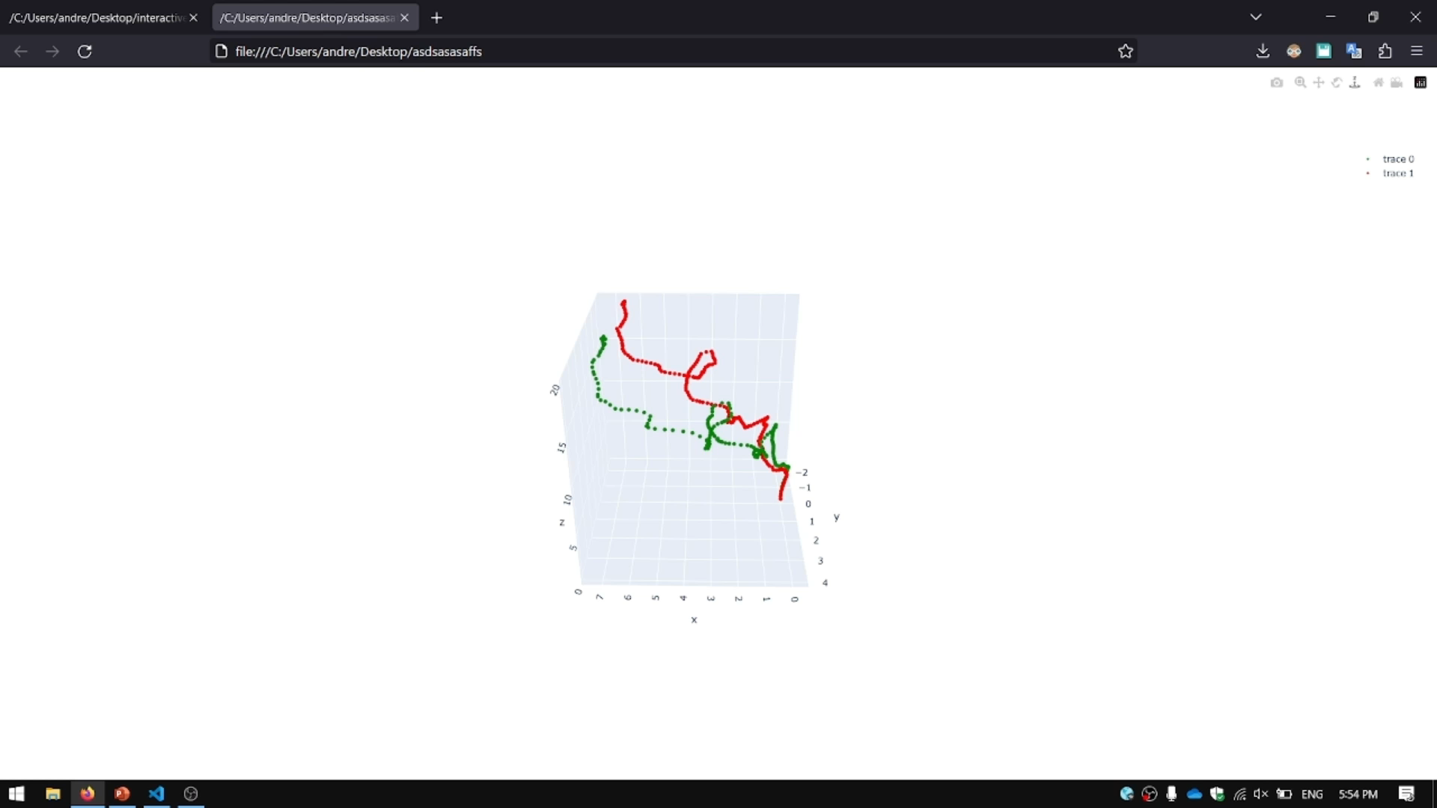
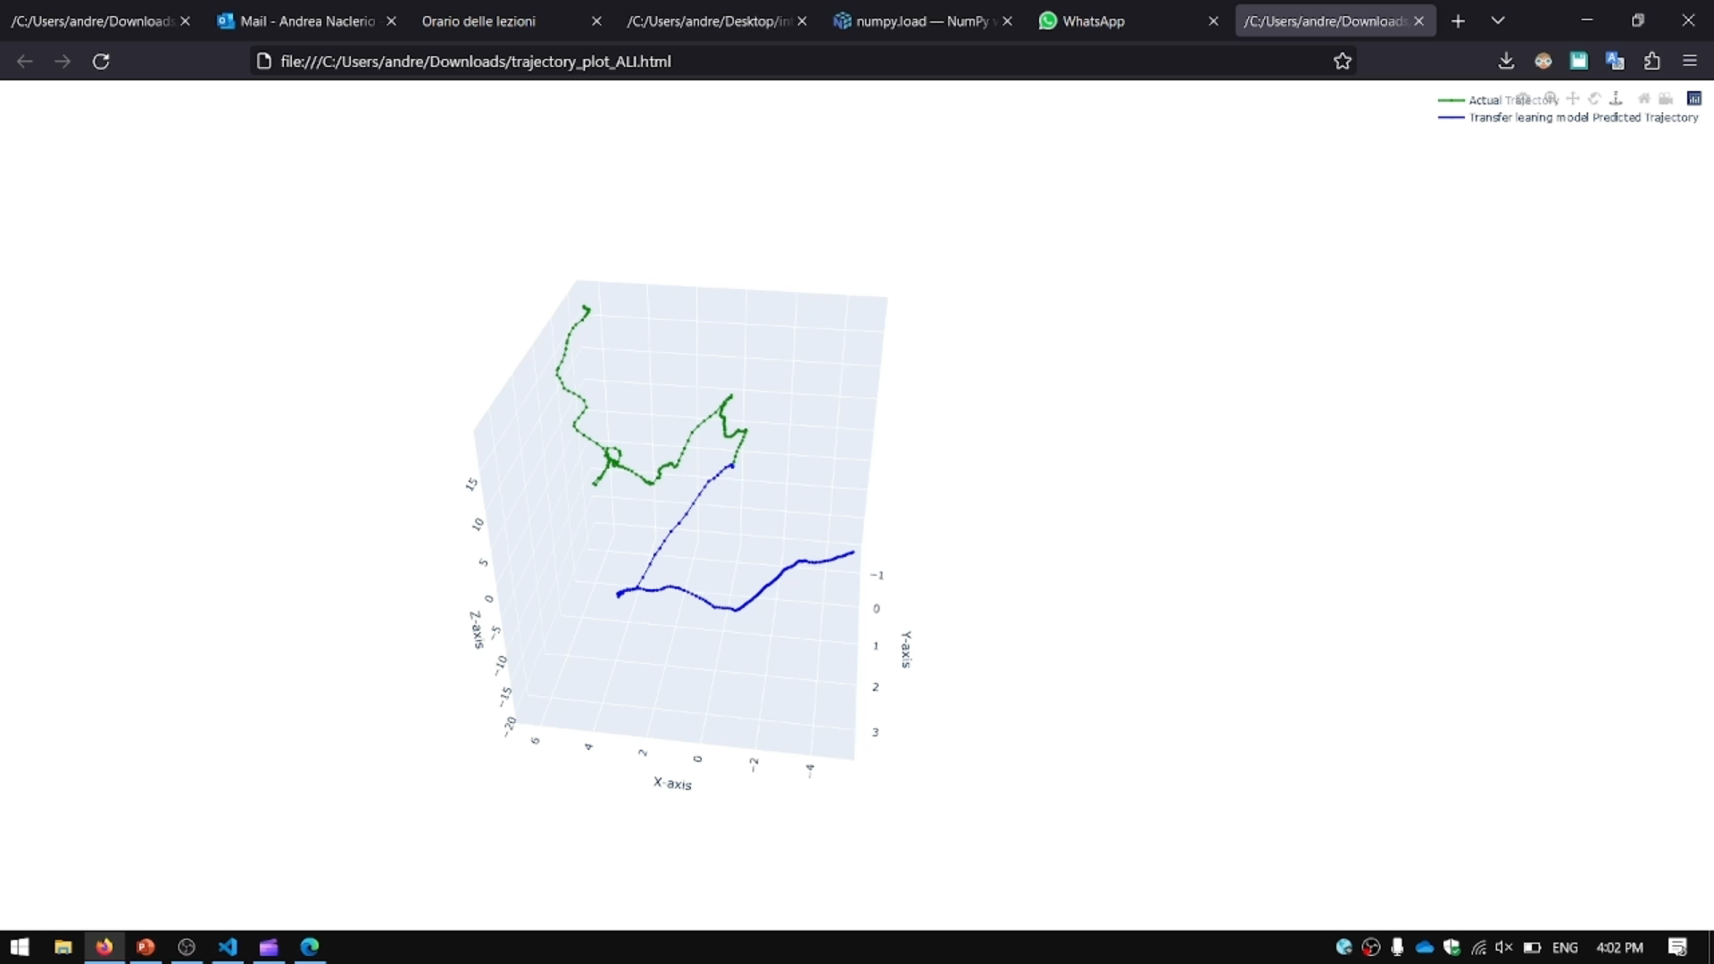
FINAL RESULTS
FROM SCRATCH MODEL
RESNET50 MODEL
FROM SCRATCH MODEL VS TARGET TRAJECTORY
RESNET 50 VS TARGET TRAJECTORY

Slide 19
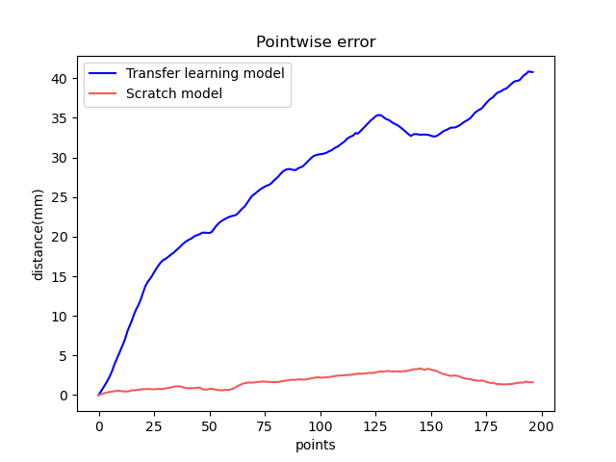
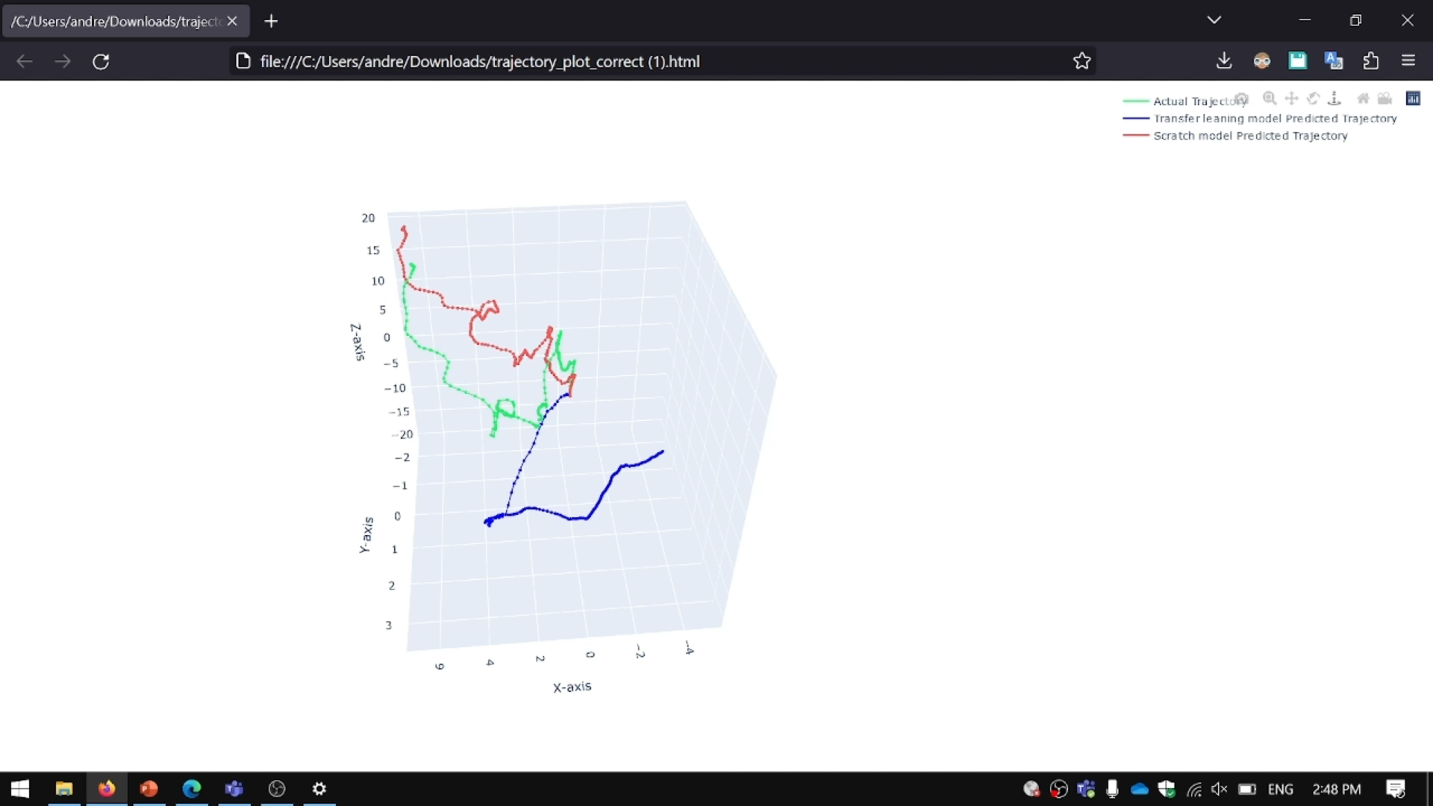
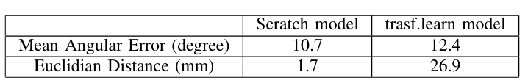
RESULTS COMPARISON
FROM SCRATCH MODEL VS RESNET 50 VS TARGET TRAJECTORY
ResNet50
Trajectory index
NUMERICAL METRICS
Resnet50

Slide 20
CONCLUSION
Limitation
Texture-less tissues and Lambertian Reflection
GPUs limitation
Computationally intensive
Overfitting
Future work
Structural similarity
Larger sequential
Non sub-sequence frames
Pretrained model on endoscopic camera dataset
Ensembled light weight models

Slide 21
THANK YOU
FOR YOUR ATTENTION
QUESTIONS ?

Slide 22
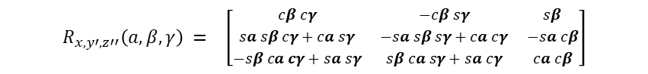
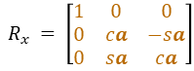

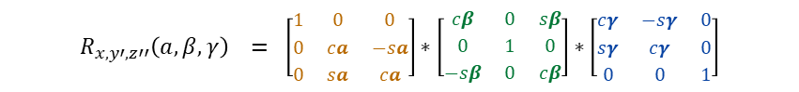
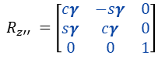
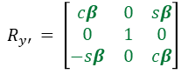
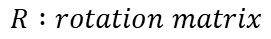
DIRECT PROBLEM
[ 𝛼 , 𝛽 , 𝛾 ]
$$R :rotation matrix$$
ROTATION MATRIX
EULER ANGLES
$$R_{x, y′,z′′}\left(a,β,γ\right)=R_{x}∗R_{y′}∗R_{z′′}$$
$$R_{x }= \left[\begin{matrix}1 & 0 & 0 \\ 0 & ca & −sa \\ 0 & sa & ca\end{matrix}\right]$$
$$R_{y′ }= \left[\begin{matrix}cβ & 0 & sβ \\ 0 & 1 & 0 \\ −sβ & 0 & cβ\end{matrix}\right]$$
$$R_{z′′ }=\left[\begin{matrix}cγ & −sγ & 0 \\ sγ & cγ & 0 \\ 0 & 0 & 1\end{matrix}\right]$$
$$R_{x, y′,z′′}\left(a,β,γ\right) = \left[\begin{matrix}1 & 0 & 0 \\ 0 & ca & −sa \\ 0 & sa & ca\end{matrix}\right]∗\left[\begin{matrix}cβ & 0 & sβ \\ 0 & 1 & 0 \\ −sβ & 0 & cβ\end{matrix}\right]∗\left[\begin{matrix}cγ & −sγ & 0 \\ sγ & cγ & 0 \\ 0 & 0 & 1\end{matrix}\right]$$
$$R_{x, y′,z′′}\left(a,β,γ\right) = \left[\begin{matrix}cβ & 0 & sβ \\ sa sβ & ca & −sa cβ \\ −sβ ca & sa & ca cβ\end{matrix}\right]∗\left[\begin{matrix}cγ & −sγ & 0 \\ sγ & cγ & 0 \\ 0 & 0 & 1\end{matrix}\right]$$
$$R_{x, y′,z′′}\left(a,β,γ\right) = \left[\begin{matrix}cβ cγ & −cβ sγ & sβ \\ sa sβ cγ+ca sγ & −sa sβ sγ+ca cγ & −sa cβ \\ −sβ ca cγ+sa sγ & sβ ca sγ+sa cγ & ca cβ\end{matrix}\right]$$

